Slide 1


Slide 2

OUR SERVICE
PROCUREMENT
Machinery And Equipment And Spare Parts
Company Stationery And Consumables
Mechanical & Electrical
Computers And Information Technology Devices & Program
SERVICE
Management Training
Manage Service
Service Operation Center

Slide 3








OUR CUSTOMERS :
PT. DHL INDONESIA
PT. ASAHI DENSO INDONESIA
PT. CIPTA MORTAR UTAMA
PT. HITACHI
PT. MORIROKU TECHNOLOGY INDONESIA
PT. ADYRAS PUTRA TECHNO
PT. ANUGERAH MEKANIKA SUKSES ABADI

Slide 4
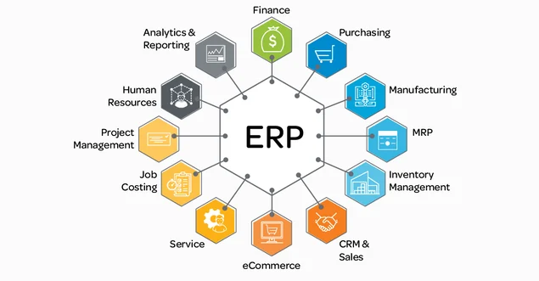
OUR SERVICE :
IT SYSTEM DIVISION (SOFTWARE)

Slide 5
Valeo’s project
warehouse management system

Slide 6

Project Scope
Requirement :
Material stock data can be updated on line and timely in case any Incoming material update
Material stock data can be updated on line and timely in case any outgoing (picking) material update
Material stock data can be updated if any cycle count activities
Material stock data can be updated if any material return from production

Slide 7
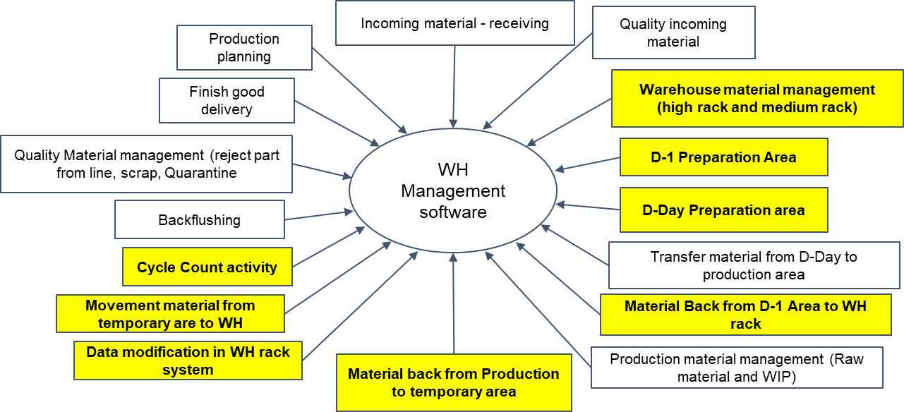
Project Scope

Slide 8


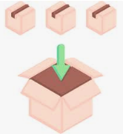







WAREHOUSE FLOW ACTIVITY
WAREHOUSE
PRODUCTION
Problem :
Wrong identification of material id, material description and quantity
No clear identification of Box
KITTING
INBOUND
OUTBOUND
RECEIVING & INCOMING INSPECTION
PICKING
Problem :
Wrong/not available material
Lost waiting time
Stop production
Problem :
Lost time for material searching
Wrong picking
PUTAWAY
Problem :
Wrong location of material
Wrong product quantity and type
Material discrepancy
KANBAN
Problem :
Lost waiting time
Not completed material quantity
Stop production
INVENTORY
Problem :
Not identify clearly in term of type and quantity
Not listed in system “unclaimed goods”
Dead stock
GOOD RETURN

Slide 9
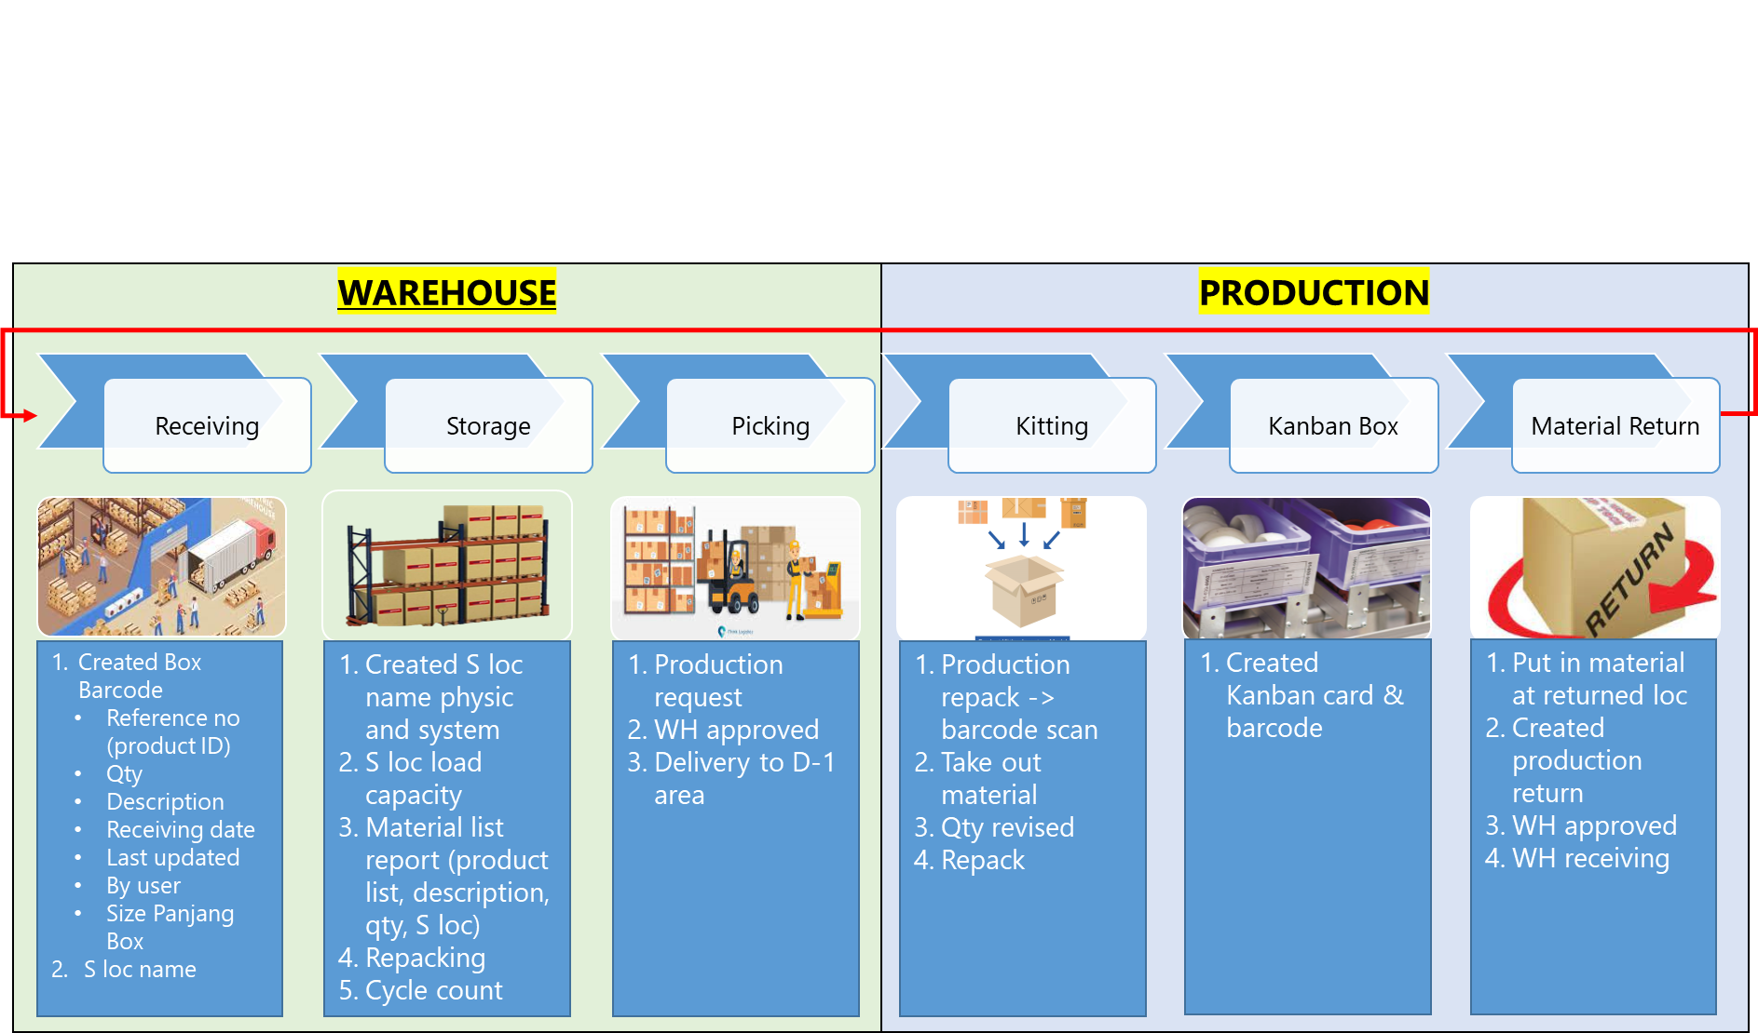
Process Flow

Slide 10




STORAGE Management
A
B
Level 4
≤ 300 Kg
A4.1
A4.2
A4.3
B4.1
B4.2
B4.3
Level 3
> 300 Kg
≤ 500 Kg
B3
A3
A3.1
A3.2
A3.3
B3.1
B3.2
B3.3
Level 2
> 300 Kg
≤ 500 Kg
B2
A2
A2.1
A2.2
A2.3
B2.1
B2.2
B2.3
A1
Level 1
> 500 Kg
B1
A1.1
A1.2
A1.3
B1.1
B1.2
B1.3
B1.1
1st alphabet : Identification of Racking
2nd alphabet : Identification of rack level
3rd alphabet : Identification number of bin

Slide 11




ADMIN ERP
(enterprise resource planning)
Admin Login
john
USERNAME
************
LOGIN

Slide 12


MASTER BOM
(BILL OF MATERIAL)
INPUT MASTER BOM
2
Warehouse
NOTIFICATIONS
Receiving Material
Request No 000﻿0001012024
Just now
List Storage
Request No 000﻿003112023
Just now
PartID
List Material Report
Re-Grouping
Part Name
Cycle Count
Production Request
Material Type
Master BOM
New data
Detail data
Save
Login as Warehouse Admin (Spesific User)

Slide 13



MASTER BOM
(BILL OF MATERIAL)
MASTER BOM
2
Warehouse
NOTIFICATIONS
Receiving Material
Request No 000﻿0001012024
Just now
List Storage
Part ID
Search
Request No 000﻿003112023
Just now
List Material Report
Re-Grouping
Cycle Count
# | Part ID | Part Name | Material Type | Qty | UOM | Action
# | Part ID | Part Name | Material Type | Qty | UOM | Action
1 | G4042715958 | BALL BEARING-F.BLACK.B17-102A7-A HAB | COMP | 100 | pc
3 | K504101 | BALL BEARING-F.HA1S.GAMMA | COMP | 50 | pc
4 | B4952655235 | CAP.Delta TG-11 | SFIN | 250 | pc
5 | G0002655603P | COMPLETE F/HOUSING.S-ENG AS.TG15 | SFIN | 500 | pc
Production Request
Master BOM
New data
Detail data
Login as Warehouse Admin (Spesific User)

Slide 14
warehouse ERP
(enterprise resource planning)
Login
john
USERNAME
************
LOGIN

Slide 15






Receiving
RECEIVING MATERIAL
2
Warehouse
NOTIFICATIONS
Receiving Material
Request No 000﻿0001012024
Just now
List Storage
Total Weight (kg)
Request No 000﻿003112023
Just now
List Material Report
Re-packing
Description
Cycle Count
#
Reference No
Material
Qty
UOM
#
Production Request
1.
...
...
...
...
Size Box
Select size
Long
Short
SUBMIT
Login as Warehouse Admin

Slide 16
Receiving
RECEIVING MATERIAL
2
Warehouse
NOTIFICATIONS
Receiving Material
S Loc
Select Loc
Request No 000﻿0001012024
Just now
List Storage
A1.1
Request No 000﻿003112023
Just now
A1.2
List Material Report
Re-packing
...
APPROVED
Cycle Count
Production Request
BARCODE
PRINT
Login as Warehouse Admin

Slide 17

Receiving
Contoh packing list

Slide 18
STORAGE
LIST STORAGE
2
Warehouse
NOTIFICATIONS
Receiving Material
Search
Request No 000﻿0001012024
Just now
List Storage
Search
Request No 000﻿003112023
Just now
List Material Report
Re-Grouping
Cycle Count
# | ProductID | Material Description | Total Qty | Location 1 | Location 1 | Location 1 | Location 2 | Location 2 | Location 2 | Location 3 | Location 3 | Location 3
# | ProductID | Material Description | Total Qty | SLoc | Qty | UOM | SLoc | Qty | UOM | SLoc | Qty | UOM
1 | S0052683 | Yoke ASS’Y. U2 EURO6 | 500 | A1.2 | 100 | pc | B2.3 | 300 | Pc | A1.5 | 100 | pc
2 | S0017313 | Yoke ASS’Y. MU. FS14 | 750 | B2.3 | 200 | pc | A3.2 | 250 | Pc | B2.6 | 300 | pc
3 | S0012303 | THRUST SPLINE M/CI TON | 1000 | B1.2 | 150 | pc | C1.3 | 500 | Pc | B1.5 | 350 | pc
4 | S00123132 | THRUST SPLINE HEATING | 400 | C1.1 | 200 | pc | D2.3 | 150 | Pc | KA | 50 | Pc
.. | ....... | ........ | ........ | .. | .. | .. | .. | .. | .. | .. | .. | ..
Production Request
List of SLoc will be followed Valeo team
Login as Warehouse Admin

Slide 19
MATERIAL REPORT
LIST MATERIAL REPORT
2
Warehouse
NOTIFICATIONS
Receiving Material
G4042605332
Search
Request No 000﻿0001012024
Just now
List Storage
Search
Request No 000﻿003112023
Just now
List Material Report
Re-Grouping
Cycle Count
Production Request
Login as Warehouse Admin

Slide 20
MATERIAL REPORT
LIST MATERIAL REPORT
2
Warehouse
NOTIFICATIONS
Receiving Material
Request No 000﻿0001012024
Just now
List Storage
Refference No. : G4042605332
Request No 000﻿003112023
Just now
List Material Report
Material Description : BALL BEARING-F.BLUE.B17-102A7-A HAB
Re-Grouping
Detail transaction
Cycle Count
# | ProductID | Material Description | Early Qty | UOM | Receiving date | Current Qty | UOM | Last updated date
1 | G4042605332 | BALL BEARING-F.BLUE.B17-102A7-A HAB | 500 | Pc | 30/08/2023 | 100 | Pc | 10/3/2024
Production Request
Login as Warehouse Admin

Slide 21
Re-Grouping
RE-GROUPING
2
Warehouse
NOTIFICATIONS
Receiving Material
Search
Request No 000﻿0001012024
Just now
List Storage
Box Number
Request No 000﻿003112023
Just now
List Material Report
Re-Grouping
Cycle Count
Production Request
Login as Warehouse Admin

Slide 22
Re-Grouping
RE-GROUPING
2
Warehouse
NOTIFICATIONS
Receiving Material
Request No 000﻿0001012024
Just now
Box Number
B000005012024
Search
Request No 000﻿003112023
Just now
List Storage
List Material Report
# | ProductID | Material Description | Location 1 | Location 1 | Location 1 | Process
# | ProductID | Material Description | SLoc | Qty | UOM | Process
1 | G4042605332 | BALL BEARING-F.BLUE.B17-102A7-A HAB | A1.3 | 300 | pc
2 | S0017313 | Yoke ASS’Y. MU. FS14 | A1.3 | 350 | pc
3 | S0012303 | THRUST SPLINE M/CI TON | A1.3 | 400 | pc
4 | S00123132 | THRUST SPLINE HEATING | A1.3 | 100 | pc
Re-Grouping
Cycle Count
Production Request
Un Pack
Un Pack
Un Pack
Un Pack
Box Number Destination
B000005012025
350
Submit
Quantity Moved
Login as Warehouse Admin

Slide 23
Re-Grouping
RE-GROUPING
2
Warehouse
NOTIFICATIONS
Receiving Material
Request No 000﻿0001012024
Just now
List Storage
Box Number : B﻿000005012024
Request No 000﻿003112023
Just now
List Material Report
Re-Grouping
Cycle Count
# | ProductID | Material Description | Location 1 | Location 1 | Location 1 | Process
# | ProductID | Material Description | SLoc | Qty | UOM | Process
1 | G4042605332 | BALL BEARING-F.BLUE.B17-102A7-A HAB | A1.3 | 300 | pc
3 | S0012303 | THRUST SPLINE M/CI TON | A1.3 | 400 | pc
4 | S00123132 | THRUST SPLINE HEATING | A1.3 | 100 | pc
Production Request
Un Pack
Un Pack
Un Pack
Login as Warehouse Admin

Slide 24
CYCLE COUNT
CYCLE COUNT
2
Warehouse
NOTIFICATIONS
Receiving Material
Request No 000﻿0001012024
Just now
Box Number
Search
Request No 000﻿003112023
Just now
List Storage
List Material Report
Re-Grouping
Cycle Count
Production Request
Login as Warehouse Admin

Slide 25
CYCLE COUNT
CYCLE COUNT
2
Warehouse
NOTIFICATIONS
Receiving Material
Request No 000﻿0001012024
Just now
Box Number
B000005012024
Search
Request No 000﻿003112023
Just now
List Storage
List Material Report
Re-Grouping
Cycle Count
# | ProductID | Material Description | Location 1 | Location 1 | Location 1 | Process
# | ProductID | Material Description | SLoc | Qty | UOM | Process
1 | G4042605332 | BALL BEARING-F.BLUE.B17-102A7-A HAB | A1.3 | 300 | pc
2 | S0017313 | Yoke ASS’Y. MU. FS14 | A1.3 | 20 | pc
3 | S0012303 | THRUST SPLINE M/CI TON | A1.3 | 400 | pc
4 | S00123132 | THRUST SPLINE HEATING | A1.3 | 100 | pc
Production Request
Un Pack
Un Pack
Un Pack
Un Pack
Submit
Login as Warehouse Admin

Slide 26
CYCLE COUNT
CYCLE COUNT
2
Warehouse
NOTIFICATIONS
Receiving Material
Request No 000﻿0001012024
Just now
List Storage
Box Number : B﻿000005012024
Request No 000﻿003112023
Just now
List Material Report
Re-Grouping
Cycle Count
# | ProductID | Material Description | Location 1 | Location 1 | Location 1 | Process
# | ProductID | Material Description | SLoc | Qty | UOM | Process
1 | G4042605332 | BALL BEARING-F.BLUE.B17-102A7-A HAB | A1.3 | 300 | pc
3 | S0012303 | THRUST SPLINE M/CI TON | A1.3 | 400 | pc
4 | S00123132 | THRUST SPLINE HEATING | A1.3 | 100 | pc
Production Request
Un Pack
Un Pack
Un Pack
Login as Warehouse Admin

Slide 27
PRODUCTION REQUEST LIST
PRODUCTION REQUEST
2
Warehouse
NOTIFICATIONS
Receiving Material
Search
Request No 000﻿0001012024
Just now
List Storage
Request No
Request No 000﻿003112023
Just now
List Material Report
Re-Grouping
# | Request No | ProductID | Material Description | Qty | UOM | Status
# | Request No | ProductID | Material Description | Qty | UOM | Status
1 | 000﻿0001012024 | A0002616564 | ALT. GAMMA AMS-D SOLID. 2B610. 110A TG11 | 400 | pc
3 | 000﻿003112023 | S0012303 | THRUST SPLINE M/CI TON | 200 | pc
4 | 000﻿002512023 | S00123132 | THRUST SPLINE HEATING | 100 | pc
5 | 000﻿002512023 | S00123132 | THRUST SPLINE HEATING A1 | 150 | pc
Cycle Count
Production Request
Approve
Approve
Approve
Approve
Login as Warehouse Admin

Slide 28
Production ERP
(enterprise resource planning)
Login
Username
************
LOGIN

Slide 29
material request
MATERIAL REQUEST
Production
ProductID
Search
Material Request
Kitting
Kanban Box
Material Return
Login as Production Admin

Slide 30
material request
MATERIAL REQUEST
Production
ProductID
A0002616564
Search
Material Request
Kitting
Product Description : ALT. GAMMA AMS-D SOLID. 2B610. 110A TG11
Kanban Box
Qty Production Planning
Calculate
Material Return
Login as Production Admin

Slide 31
material request
MATERIAL REQUEST
Production
ProductID
A0002616564
Search
Material Request
Kitting
Product Description : ALT. GAMMA AMS-D SOLID. 2B610. 110A TG11
Kanban Box
Qty Production Planning
250
Calculate
Material Return
Login as Production Admin

Slide 32
material request
MATERIAL REQUEST
Production
ProductID
A0002616564
Search
Material Request
Kitting
Product Description : ALT. GAMMA AMS-D SOLID. 2B610. 110A TG11
Kanban Box
Production Planning
250
Calculate
Material Return
Bill of Material
# | ProductID | Material Description | Material need | Stock on Hand | Location 1 | Location 1 | Location 1 | Location 2 | Location 2 | Location 2 | Location 3 | Location 3 | Location 3
# | ProductID | Material Description | Material need | Stock on Hand | SLoc | Qty | UOM | SLoc | Qty | UOM | SLoc | Qty | UOM
1 | A0002616564 | ALT. GAMMA AMS-D SOLID. 2B610. 110A TG11 | 250 | 500 | A1.2 | 100 | pc | B2.3 | 300 | Pc | A1.5 | 100 | pc
2 | B8102616565 | COVER ASS'Y. GAMMA AMS-D SOLID TG11 | 250 | 750 | B2.3 | 200 | pc | A3.2 | 250 | Pc | B2.6 | 300 | pc
3 | G4022609999 | F/BRACKET M/C.GAMMA ISG | 250 | 1000 | B1.2 | 150 | pc | C1.3 | 500 | Pc | B1.5 | 350 | pc
4 | B1402655331 | FLANGE NUT. M5X0.8P | 500 | 400 | C1.1 | 200 | pc | D2.3 | 150 | Pc | KA | 50 | Pc
Material Request
Login as Production Admin

Slide 33
material request
MATERIAL REQUEST
Production
ProductID : A0002616564
Material Request
Kitting
Product Description : ALT. GAMMA AMS-D SOLID. 2B610. 110A TG11
Quantity Material Request :
200
Kanban Box
Material Return
UOM : pc
SUBMIT
Login as Production Admin

Slide 34
material request
MATERIAL REQUEST
Production
ProductID : A0002616564
Material Request
Kitting
Product Description : ALT. GAMMA AMS-D SOLID. 2B610. 110A TG11
Kanban Box
Material Request : 400
Material Return
Request No. : 0000001012024
Request will pop up via notif message to WH Picking team, WH leader, Production planning & production leader & admin
Login as Production Admin

Slide 35
kitting
KITTING
Production
Box Number
Search
Material Request
Kitting
Kanban Box
Material Return
Login as Production Admin

Slide 36
kitting
KITTING
Production
Box Number
B000001012024
Search
Material Request
Kitting
Kanban Box
# | ProductID | Material Description | Location 1 | Location 1 | Location 1
# | ProductID | Material Description | SLoc | Qty | UOM
1 | G4042605332 | BALL BEARING-F.BLUE.B17-102A7-A HAB | D-1 | 300 | pc
2 | S0017313 | Yoke ASS’Y. MU. FS14 | D-1 | 350 | pc
3 | S0012303 | THRUST SPLINE M/CI TON | D-1 | 400 | pc
4 | S00123132 | THRUST SPLINE HEATING | D-1 | 100 | pc
Material Return
Request No.
0000001012024
Search
Login as Production Admin

Slide 37
kitting
KITTING
Production
Box Number : B000001012024
Material Request
Request No. : 0000001012024
Kitting
Kanban Box
# | ProductID | Material Description | Material need | Location 1 | Location 1 | Location 1
# | ProductID | Material Description | Material need | SLoc | Qty | UOM
1 | G4042605332 | BALL BEARING-F.BLUE.B17-102A7-A HAB | 500 | D-1 | 300 | pc
2 | S0017313 | Yoke ASS’Y. MU. FS14 | 0 | D-1 | 350 | pc
3 | S0012303 | THRUST SPLINE M/CI TON | 0 | D-1 | 400 | pc
4 | S00123132 | THRUST SPLINE HEATING | 0 | D-1 | 100 | pc
Material Return
Un Pack
Login as Production Admin

Slide 38
kitting
KITTING
Production
Box Number : B000001012024
Material Request
Request No. : 0000001012024
Kitting
Kanban Box
# | ProductID | Material Description | Material need | Location 1 | Location 1 | Location 1
# | ProductID | Material Description | Material need | SLoc | Qty | UOM
1 | G4042605332 | BALL BEARING-F.BLUE.B17-102A7-A HAB | 200 | D-1 | 0 | pc
2 | S0017313 | Yoke ASS’Y. MU. FS14 | 0 | D-1 | 350 | pc
3 | S0012303 | THRUST SPLINE M/CI TON | 0 | D-1 | 400 | pc
4 | S00123132 | THRUST SPLINE HEATING | 0 | D-1 | 100 | pc
Material Return
Login as Production Admin

Slide 39
kanban box
KANBAN
Production
ProductID
G4042605332
Material Request
Kitting
Quantity
50
Kanban Box
Material Return
Production Planning
PP00000001012024
Print
Login as Production Admin

Slide 40
kanban box
KANBAN CARD
Product ID : G4042605332
Product Description : BALL BEARING-F.BLUE.B17-102A7-A HAB
Product Qty : 50
Product Plan : PP00000001012024
Login as Production Admin

Slide 41
MATERIAL RETURN
MATERIAL RETURN
Production
Material Request
Kitting
Kanban Box
Material Return
Description
#
Reference No
Material
Qty
Unit
#
1.
...
...
...
...
SUBMIT
Login as Production Admin

Slide 42









thank you!

